Slide 1

IOT FACE MASK DETECTION AND BODY TEMPERATURE
A.LOKESH YADAV -21K81A7404
B.SARAYU - 21K81A7405
B.VENKATESH - 21K81A7406
B.SANDHYA - 21K81A7407
UNDER THE GUIDANCE OF
MALI BABU
ASSISTANT PROFESSOR DEPARTMENT OF COMPUTER SCIENCE AND DESIGNING

Slide 2
ABSTRACT :
The first step to detect COVID is by scanning for fever. Also we need to monitor every person for a mask. We have temperature checking systems for every entrance for scanning but manual temperature scanning has a lot of disadvantages. The personnel are not well trained on using temperature scanner devices. There is human error in reading values. Many times people are not barred from entry even after higher temperature readings or no masks. The scanning is skipped by the personnel if supervisors are not watching. Manual scanning system is not suitable for large crowds. To solve this problem we here propose a fully automated temperature scanner and entry provider system. It is a multipurpose system that has a wide range of applications. The system makes use of a contactless temperature scanner and a mask monitor. The scanner is connected directly with a human barrier to bar entry if high temperature or no mask is detected.
KEYWORDS: Raspberry Pi, open CV, python, camera and LCD, covid 19, HDMI/DVI, temperature sensor,IOT

Slide 3
INTRODUCTION :
The purpose of the project is to detect the person perfectly wearing mask or not and temperature detection of the person if the both are correct then the door allows the person in and there will be automatic sanitization these consists of temperature sensor, raspberry Pi model 3b also we are using a IOT based technology to store the data and some other components like buzzer, motor, lcd. Having both conditions is instantly allowed inside. The system uses a temperature sensor and camera connected with a raspberry pi system to control the entire operation. The camera is used to scan for masks and temperature sensors for forehead temperature. The raspberry processes the sensor inputs and decides whether the person is to be allowed. In this case the system operates a motor to open the barrier allowing the person to enter the premises. If a person is flagged by the system for high temperature
or no Mask the system glows the red light and bars the person from entry. Also the face and temperature of a person is transmitted over IOT to the server for authorities to take action and test the person for covid.

Slide 4
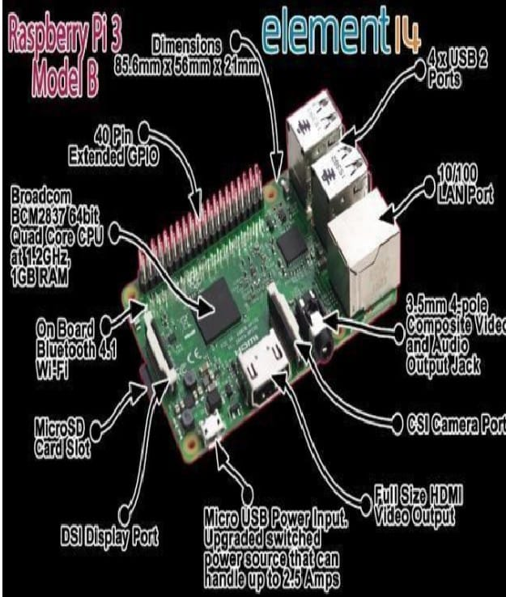
Thus the system provides a 100% automated system to prevent the spread of COVID. Raspberry Pi display and connectivity cable any HDMI/DVI monitor and any TV should work as display for the pi. For the best results, we used one with HDMI input, but other connections are available for older devices. Keyboard and mouse will work any standard USB keyboard with our raspberry pi SD card. We recommend an 8GB class 4 SD card, ideally pre installed with NOOBS. We all need a good power supply which can supply at least 2A at 5V for the model 3b Pi.

Slide 5
DESCRIPTION OF EXCITING MODEL
This model consists of raspberry pi and temperature sensor, interfacing circuit, camera, buzzer,
LCD display, driver circuit, Door access and a sanitizer motor.
In the existing model there is only mask detection which detects the face of the person wearing
mask or not on this proposed model we have used the
Fig: Block diagram of Existing model
Temperature sensor and the automatic Sanitization the model.

Slide 6
DESCRIPTION OF PROPOSED MODEL :
The LM35 is an integrated circuit sensor that can be used to measure temperature with an electrical
output proportional to the temperature (in oC) The LM35 – An Integrated Circuit Temperature
Sensor.
Why Use LM35s to Measure Temperature or can measure temperature more accurately than using
a thermistor. The sensor circuitry is sealed and not subject to oxidation, etc. The LM35 generates
a higher output voltage than thermocouples and may not re

Slide 7
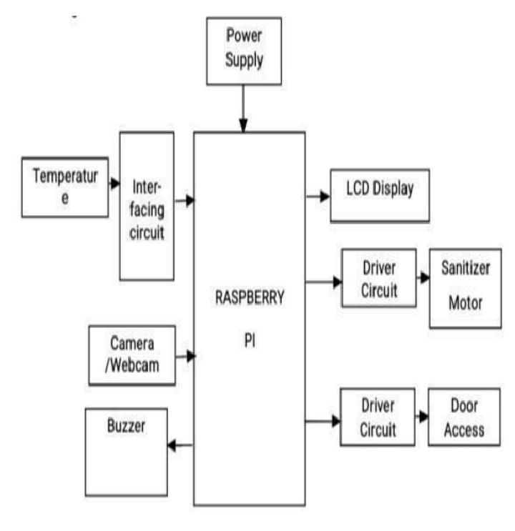
FIG : BLOCK DIAGRAM OF PROPOSED MODEL

Slide 8
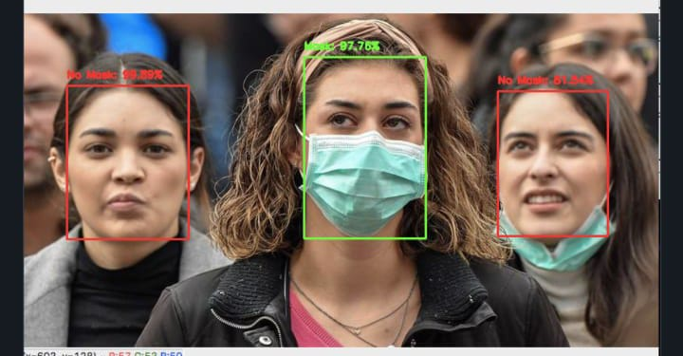
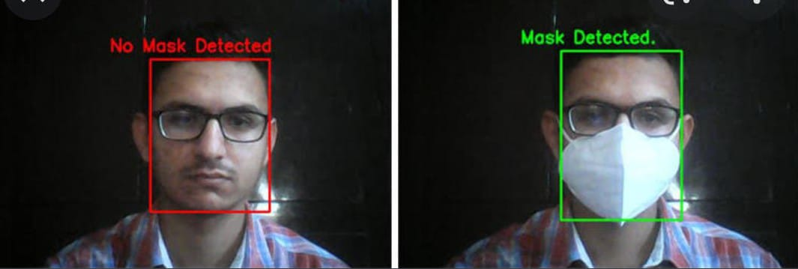

Slide 9
SYSTEM REQUIREMENTS :
RAM : 4GB
Storage : 500 GB
CPU : 2 GHz or faster
Architecture : 32-bit or 64-bit
Operating system :windows 7 and above or linux based OS or MAC OS

Slide 10
EXPERIMENTAL RESULTS :
This study deals with controlling the spread of COVID-19 according to the WHO’s given instructions for public safety and awareness. As we discussed in the methodology section, our proposed model consists of two modules .The first module deals with contact free temperature detection and abnormal temperature individual’s record-keeping system to disinfects using sanitizing liquid. In the second module of our proposed system, we implemented a mask detection and classification system in which our system is trained to detect and classify the individual’s face mask in three classes, which are face with proper mask (FWPM),face with improved mask (FWIPM),and face f without mask(FWOM) while they are passing from SSDWG .The system is trained using different machine learning models, and we achieved good accuracy on the test data in experiments.
Our proposed SSDWG is designed for all kinds of public places, we want to ensure that individuals have to pass from SSDWG .The attached sensors to this gate are activated;
A contact-free temperature measuring sensor detects the person’s temperature. The CCTV module captures the image from a surveillance video of the person whose temperature 100F or more than 100F , and system will store the data in the database with status of suspected.

Slide 11
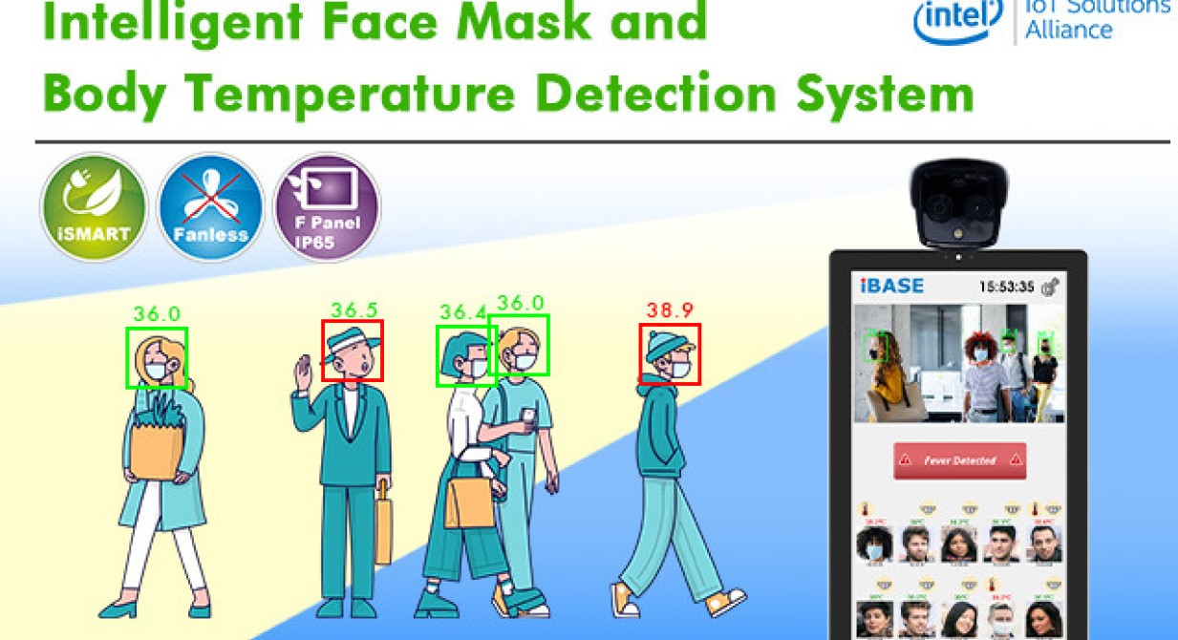
As mentioned before, the face mask detection module detects and classifies individuals face mask in three classes : FWPM, FWIPM, and FWOM. The disinfection module showers sanitizing liquid on the person for 10s while passing from SSDWG.The person controlling the entrance can divert suspicious persons for COVID -19 testing. For the experiments, we used three datasets . Our proposed model achieved a high accuracy on the combined dataset using the VGG-16. The comparative accuracy of VGG-16 on all datasets(MAFA and face-net are available on Github,and third dataset from Bing).

Slide 12
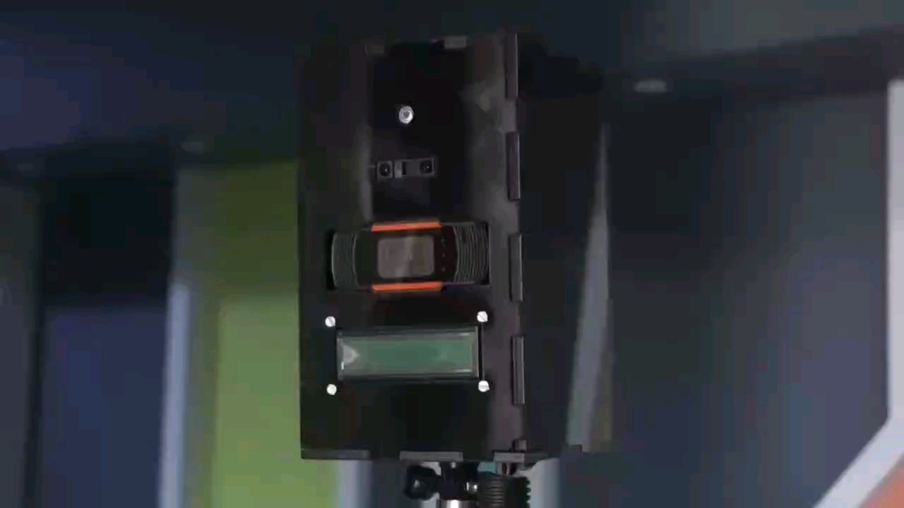

Slide 13
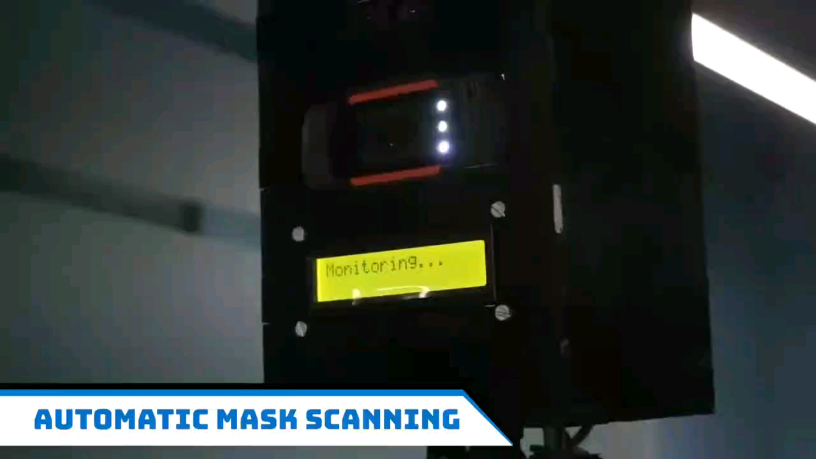

Slide 14
CONCLUSION:
we have effectively implemented an operational prototype of the face mask and body temperature in this company. This company can be used in places where there are mass gatherings, such as universities, schools, workplaces, stores, etc . The system first detects if the character is wearing a mask and sends the records to the microcontroller. The non-contact temperature sensor reads the body temperature of a man or woman and, when checked, opens the barrier arm and allows the woman or man enter. With the help of this challenge , the automated response is implemented; Therefore no human needs to view COVID-19 protocols. The accuracy of facemask detection can be completed by marking the unit with a larger image dataset . Ultimately, detecting temperature of the mask and frame can help us reduce the massive accumulation of people in one place without a mask, reducing the possibility of ignition. Experimental effects showed that the proposed method had better overall performance compared to the current algorithms

Slide 15
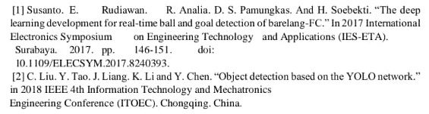
REFERENCE

Slide 16


